Slide 1
Irrigation Pod meeting
Alan Williamsons Property and Omakau Rugby pavilion
1st and 2nd Sept

Slide 2
Lived all my early life in Paerau, Maniototo
Took over the family farm in 1992
Undertook an Equity partnership (30%) in 1995
Proceeded to develop from the “then” farming practice to what currently is deer breeding/finishing/velvet/cattle breeding and finishing and usually lamb plan (1000-2000)
In stock units approx. 4500 (1992) to 8000 (2000)
Mainly through irrigation and intensification

Slide 3
Why development and why irrigation??
If we didn't have a viable farming business
then
succession was not an option
Irrigation allowed us the ability to guarantee our production and limit our costs
Gives us (and successors) the ability to exhaust all farming models in the future i.e. it wouldn't limit the business to what it could only do then

Slide 4
My journey
1999 - Burwood station in Te Anau for NZDF
2001 – Hakataramea in Kurow
2004 – Northern Op,s manager for NZDF
2008 – Operations manager for Landcorp Weka
2012/13 – Operations Manager for TH Enterprises Ltd
currently

Slide 5
My learnings
Start at the start
“ if you don't know where you want to go, how are you going to get to where you want to be”
“if you always do what you have always done, you will always get what you always got”

Slide 6
So, start at the start
Engage all affected parties in robust discussions (mother, father, sister, brother, grand mother, grand father, son, daughter, dog , cat, etc.)
Use professional help to understand and plan including your finance and legal team
we are a jack of all trades and usually a master of none
You will arrive at a point where you have a business plan or vision of where you and all involved know what the game plan is.

Slide 7
We missed this point
Discussed with family , had financial and legal advice
Realised we needed to develop to have a robust, sound business that was profitable for future- for us that was irrigation( meant land use change and intensification)
Entered into a Equity Partnership
BUT
Didn't really have a solid vision or game plan

Slide 8
Where to for our business???
Need to establish a business plan
Need to model our business on our business plan
expansion verse consolidation?
Partnership growth or personal growth?
Time frame of our Equity partnership?
Introduction of either formal or advisory governance

Slide 9
Why have Governance??
Opportunities
Strategic growth and developments
Succession
Collective ideas and decision making (expertise)
Direction to achieve the business's purpose
Compliance- Nutrients and health and safety
Planning and reporting
Support for business owners
Support for staff

Slide 10
Good Governance should
Bring accountability
Bring performance focused collective decision making
breathe enthusiasm
Have robust debate on all points
Embrace honesty
be connected to business
Understand Governance vs. Management

Slide 11
Obstacles
Knowledge and skills
Personal attributes
Letting go?
Resources and people

Slide 12
Good Governance does not necessarily mean that there is good performance, but poor business performance is usually the result of no or poor governance

Slide 13
Vision of Trevor and Harriet
“ To benefit our family now and in the future around educational, employment and business opportunities”

Slide 14
Vision statement
“To create a truly multi generational family owned agri business complete with formal Governance, producing sustained growth and wealth creation through the leverage of the current asset of T H Enterprises”

Slide 15
Board consists of
Four members, two independent and the two owners of the business
South island operation manager sits on board with no voting rights
Chair is independent of business
Four completely different people bringing their different strengths and dynamics to the business
“Meetings with successful governance is no place for egos, please leave them at the door”

Slide 16
Development
Loganbrae – 1996 (Deer, irrigation)
The Wandle (NZDF) – 2004 (Deer)
Four square (landcorp) – 2009/10- grazing block
Blair's Dairy unit (Landcorp) -2010/11- 450ha dairy unit for 1000 cows
Weka swamp (landcorp) – 2011/12 – 300ha dairy support
Darfield dairy (TH Enterprise) -2014 – 275 ha dairy farm for 1050 cows, fully irrigated

Slide 17
Development
Plan, development must fit the business plan and must fit the property
Get expert advice (trust)
Compliance is massive and time consuming, take it seriously
Spend time exhausting all possibilities, don't make spur of the moment decisions
Quote for everything but remember cheapest is not always the best
Do it once, do it right, DO NOT CUT CORNERS
You are spending a lot of money therefore it needs to perform at maximum, e.g. grass, fert, growth rates, infrastructure etc.

Slide 18
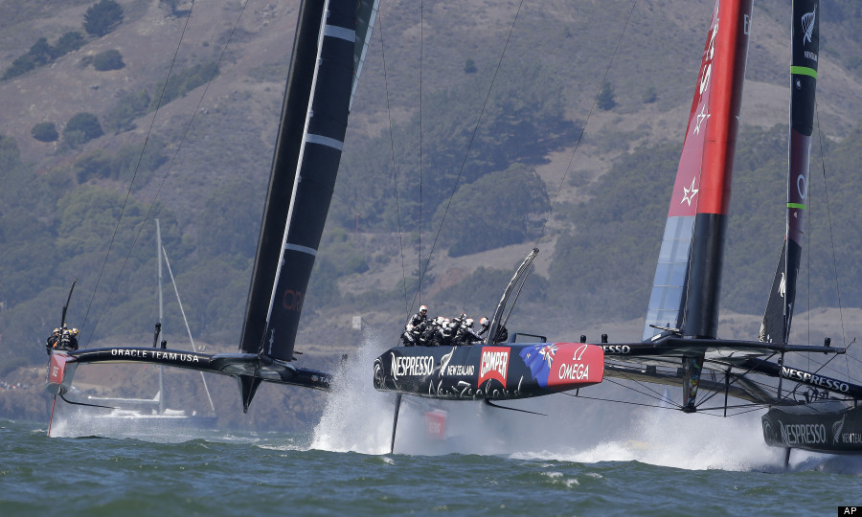

Slide 19
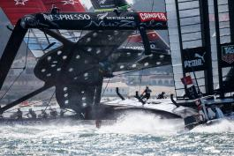

Slide 20
equity partnership
Pros
Cons
Creates capital
Lessons risk
Expertise
Reporting
Structure around ownership, governance etc.
Less control
Personalities
Alignment of expectations re timelines, dividends etc.
Reporting and compliance
Structures and documentation

Slide 21
Business plan and vision
succession
development
communication
delivery
understanding
Team work
trust
governance
Partnerships

