Slide 1
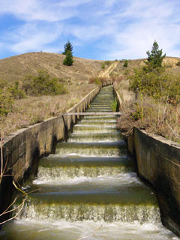

The Changing Face of Farming
Presented by:
George Collier
ICL Limited, Chartered Accountants
www.iclca.co.nz

Slide 2
What Business Are Farmers In?

Slide 3
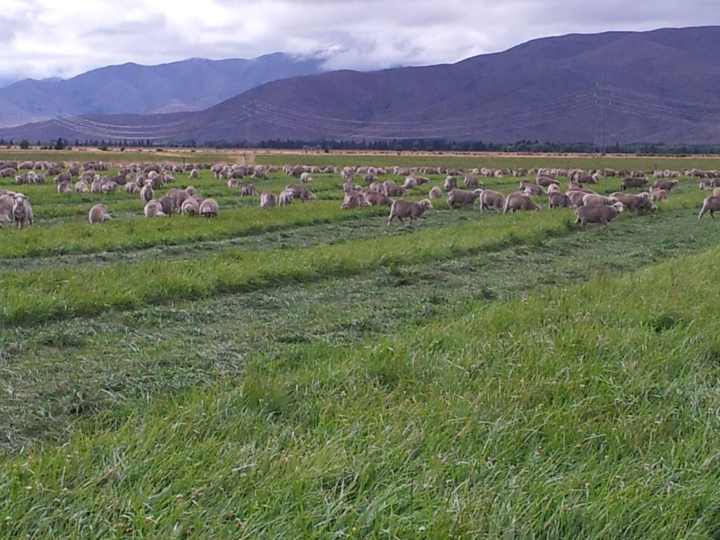

Slide 4
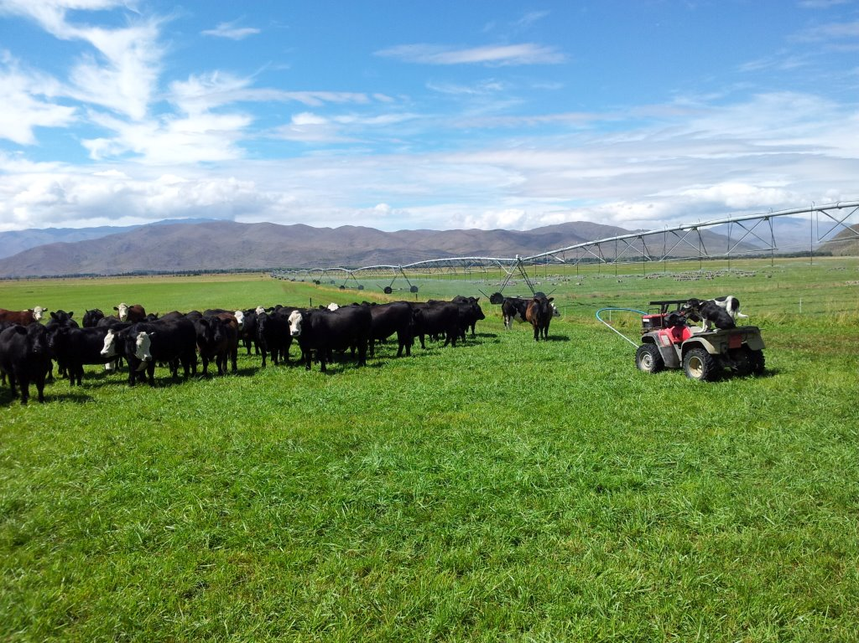

Slide 5
ROA & Increase In Land Value
2014
Estimate

Slide 6
Assets, Equity & Debt 2001-2014
Central Otago Farming Business Balance Sheet

Slide 7
Average Central Otago Farming Business
Last 13 Years (2001 – 2014)
 |  | $ 8,000 stock units | Annual % ↑ | Annual Compound
Assets $280 to $1000/su | +260% | + $5.76m | + 12% | + 9%
Debt $80 to $160/su | +100% | + $0.64m | + 8% | + 6%
Equity $200 to $720/su | +260% | + $5.12m | + 12% | + 9%

Slide 8
Land Values
→ Providing 85% of Increase in Wealth Over Time
Land Value Driver – Shift from land → reliable water → nutrient caps.
Access to reliable water is now driving land value.
Nutrient Caps will limit land value in future.
Land Value Drivers | Old | New
Returns | √ | √
Access to Debt/Capital | √ | √
Cost of Debt/Capital | √ | √
Access to Water | √ | √
Access to Reliable Water |  | √
Ability for Land Use Charge |  | √
Nutrient Limits |  | √

Slide 9
Value of Water & Its Impact On Land Price

Slide 10
What Are The Implications of Legislation
Driven From the National Fresh Water Policy Framework
Regional Council Outcomes:
Nutrient Limits - Plan Change 6A (2020)
- 30 kg Nitrate leachate/hectare
May limit some land use intensification
Efficiency Use of Water - Plan Change 1C (2021)
May affect some irrigation applications methods in some locations

Slide 11
Irrigation Efficiency
(The Amount of Water Applied That Stays In The Soil)
Centre Pivot | 90%
Roto-Rainer | 80%
Big Gun | 75%
K-Line | 70%
Border Dyke | 55%
Winter Flood | 45%
Increased efficiency leads to more intensive farming systems
Increased production is essential
Differences within the catchment depending on the ability to reuse the water

Slide 12
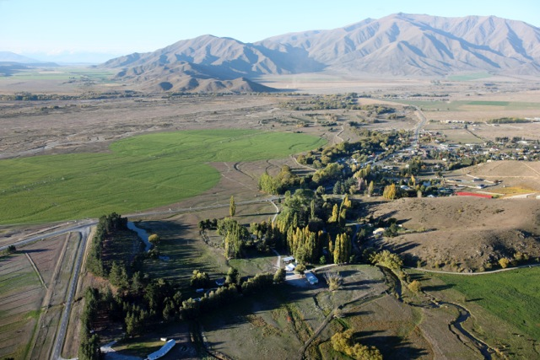

Slide 13
Irrigation Systems
Pasture Yield (kg DM/ha)

Slide 14
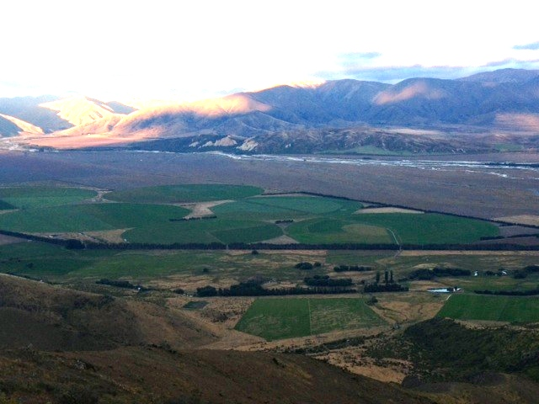

Slide 15
Technology Driving Productivity
Crop Yields | Crop Yield | Cost/ha | Cost/kg DM | Return c/kg DM | Net Return c/kg DM | Net Surplus
Pivot | 25,000 F-Beet | 2500 | 10c | 27c | 17c | 4,250
 | 15,000 Kale | 1500 | 9c | 27c | 18c | 2,880
Gun | 12,000 Kale | 1,300 | 10c | 27c | 17c | 2,040
K-Line | 11,000 Kale | 1,200 | 11c | 27c | 16c | 1,700
Border Dyke | 9,000 Kale | 1,000 | 10c | 27c | 17c | 1,530
Wild Flood Irrigation | 8,000 Kale | 1,000 | 10c | 27c | 17c | 1,360
Dryland | 5,000 Kale | 800 | 16c | 27c | 11c | 700

Slide 16
Conclusion
1. Every Farming Business Has To Work Out A Strategy
  Vision for Family & The Business
    Growth Scale - /Diversity of land Use
    Profitability
    Enable Family & Farm Succession
  Staying the Same - but legislation is driving change
  Selling - repurchasing elsewhere
  - exit
  Retaining a passive investment – J.V. Model
Land price will be influenced by access to reliable water & nutrient limitations
Technology will continue to drive productivity
We need to target high paying markets
Strategy

Slide 17
